Slide 1


Email Classification System using NLP & Machine Learning
A GENAI-based automated email categorization project
Presented by: [Student Name(s)], [University Name], [Year]
Notes:
1

Slide 2

Introduction: Navigating the Email Deluge
In today's digital age, the sheer volume of emails makes manual sorting incredibly inefficient and prone to errors. Important communications can easily be overlooked amidst a flood of less critical messages.
Our project aims to leverage artificial intelligence to automate this critical task, categorizing emails into predefined, actionable groups such as Urgent, Financial, HR, General, and Spam.
Notes:
2

Slide 3





Problem Statement: The Manual Sorting Predicament
Slow & Inconsistent
Critical Emails Lost
Manual filtering is time-consuming and lacks uniformity across different users, leading to bottlenecks and inefficiencies.
Without an automated system, vital messages can get buried, potentially leading to missed opportunities or critical delays.
Spam & Phishing Risks
The increasing sophistication of spam and phishing attacks demands robust, AI-powered defense mechanisms.
Notes:
3

Slide 4

Project Objectives: Crafting an Intelligent Solution
Multi-Category Classification
Develop an NLP and Machine Learning model capable of accurately classifying emails into multiple predefined categories.
High-Accuracy Spam Detection
Implement robust algorithms to detect and filter out spam with a high degree of precision, improving inbox hygiene.
Real-time Web Interface
Integrate the classification model into a user-friendly web application for real-time email analysis and feedback.
Boost Productivity
Significantly enhance organizational productivity and streamline workflow by automating email management.
Notes:
4

Slide 5

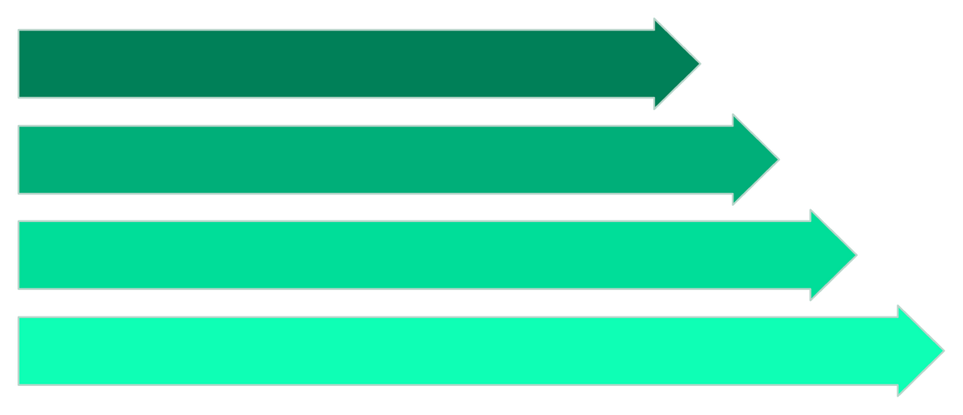
System Architecture: From Input to Insight
User Input
Frontend
Flask API
Preprocessing
Our system follows a clear, modular architecture, ensuring efficient processing from the user's initial input to the final categorized output. This design allows for scalability and future enhancements.
Notes:
5

Slide 6



Key Technologies & Techniques Utilized
Python & Flask
Web Technologies
NLP Techniques
The core programming language and a lightweight web framework for backend development.
HTML, CSS, and JavaScript for building an intuitive and responsive user interface.
Including tokenization and stopword removal for effective text cleaning and feature extraction.
ML Models
TF-IDF Vectorizer
Explored Logistic Regression and Naive Bayes for robust classification.
Converting raw text into numerical feature vectors suitable for machine learning algorithms.
Notes:
6

Slide 7

Dataset Preparation & Preprocessing Pipeline
Cleaning Emails Removal of punctuation, URLs, and special characters to ensure clean text input.
Tokenization Breaking down text into individual words or tokens, forming the basis for analysis.
Stopword Removal Eliminating common words (e.g., "the," "is") that add little value to classification.
TF-IDF Vectorization Transforming cleaned text into numerical feature vectors, representing word importance in documents and across the corpus.
Notes:
7

Slide 8
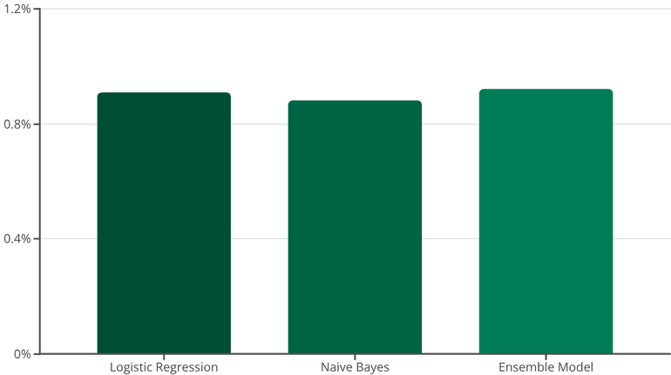
Model Training & Performance Metrics
Our dataset was divided into training and testing sets to ensure robust model evaluation. We rigorously tested multiple machine learning algorithms, focusing on their ability to accurately classify diverse email content.
Train-Test Split: Standardized data partitioning for unbiased evaluation.
Algorithms Tested: Evaluated Logistic Regression and Naive Bayes for optimal performance.
Achieved Accuracy: Models consistently demonstrated an accuracy range of 87-92%.
Model Selection: The final model was chosen based on its superior balance of accuracy, precision, and recall across all categories.
Notes:
8

Slide 9



Seamless Frontend & Robust Backend Integration
Backend: Flask API
The /classify API endpoint handles email submissions. It loads the pre-trained email_model.pkl and vectorizer.pkl to process and predict email categories, returning results as a structured JSON object including category, confidence score, and spam status.
Frontend: User Interface
A clean web interface features a text box for email input and sample buttons for quick testing. It leverages Fetch API calls to send email content to the backend. Results are dynamically displayed using badges for category, a clear spam indicator, and a confidence bar for prediction certainty.
Notes:
9

Slide 10


Conclusion & Future Directions
Conclusion
Future Work
Enhanced Efficiency: AI significantly improves email classification speed and accuracy.
Advanced Models: Integration of BERT/Transformers for deeper contextual understanding.
Effective Automation: Our NLP model provides an effective solution for automated email management.
Multilingual Support: Expanding classification capabilities to multiple languages.
Deployable System: We have developed a user-friendly and readily deployable system.
API Integration: Direct integration with Gmail/Outlook APIs for seamless user experience.
Cloud Deployment: Hosting the system on cloud platforms for scalability and accessibility.
GENAI Summarization: Implementing GENAI for intelligent email summarization.
Notes:
10

